Slide 1
Solid State Physics
Statistical Mechanics
Band Theory of Solids

Slide 2
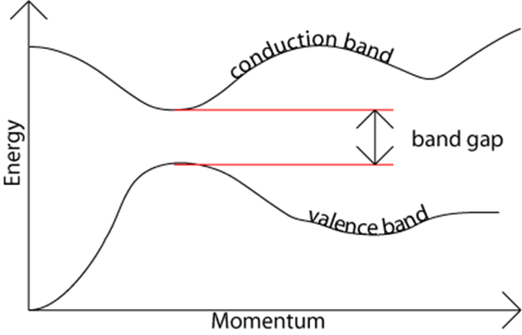
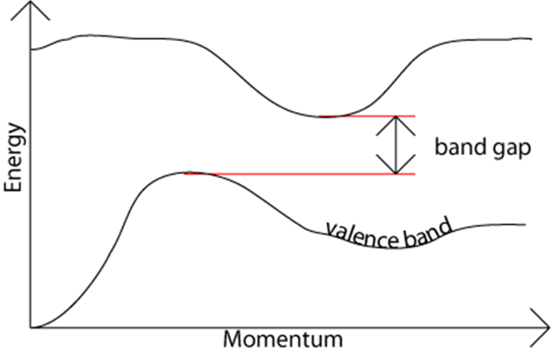
Variation of Energy bands
As III-V ternary and quaternary alloys are varied over their composition ranges, their band structures change.
For example, the band structure of GaAs and AlAs, and the way in which the bands change with composition x in the ternary compound Al_{x}Ga_{1-x} As.

Slide 3
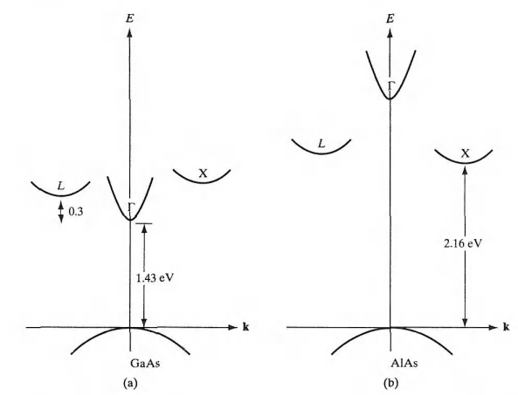
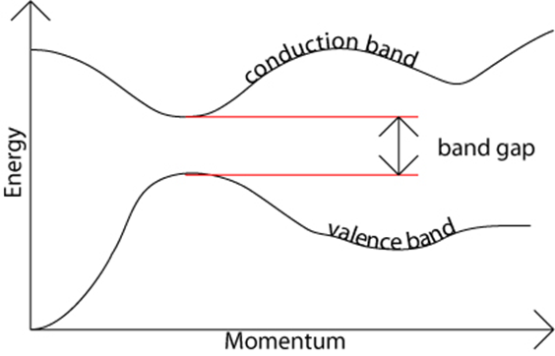
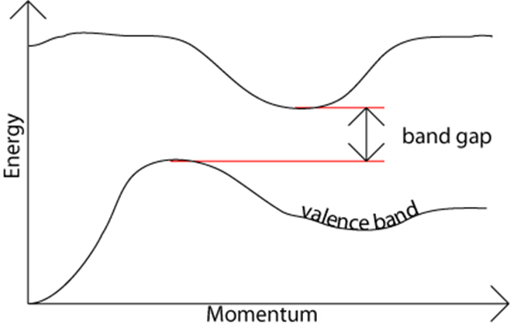
Variation of direct and indirect conduction bands in AIGaAs as a function of composition
The (E,k) diagram for GaAs, showing three minima in the conduction band;
The (E,k) diagram for AlAs, showing three minima in the conduction band;

Slide 4
Variation of Energy bands
The binary compound GaAs is a direct material, with a band gap of 1.43 eV at room temperature.
For reference, we call the direct ( k = 0) conduction band minimum Γ.
There are also two higher-lying indirect minima in the GaAs conduction band, but these are sufficiently far above Γ that few electrons reside there.
We call the lowest-lying GaAs indirect minimum L and the other X.
In AlAs the direct Γ minimum is much higher than the indirect X minimum, and this ma­terial is therefore indirect with a band gap of 2.16 eV at room temperature.

Slide 5
Variation of Energy bands
Since light emission is most efficient for direct materials, in which elec­trons can drop from the conduction band to the valence band without chang­ing k (and therefore momentum),
LEDs in GaAsP are generally made in material grown with a composition less than x = 0.45.
For example, most red LEDs in this material are made at about x =0.4, where the Γ minimum is still the lowest-lying conduction band edge, and
where the photon resulting from a direct transition from this band to the valence band is in the red portion of the spectrum (about 1.9 eV).
The radiative re­combination in indirect materials can be enhanced by adding the impurities.

Slide 6
Effective Mass

Slide 7
Effective Mass
The electrons in a crystal are
not completely free,
interact with the periodic potential of the lattice.
As a result, their "wave-particle" motion cannot be expected to be the same as for electrons in free space.
Thus, in ap­plying the usual equations of electrodynamics to charge carriers in a solid, the altered values of particle mass should be used.
To account for most of the influences of the lattice, so that the electrons and holes can be treated as "almost free" carriers in most computations.
The calculation of effective mass must take into account the shape of the energy bands in three-dimensional k-space, taking appropriate averages over the various energy bands.

Slide 8
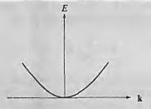


Effective Mass
the electron momentum is p = mv = ħk. Then
Thus the electron energy is parabolic with wave vector k. The electron mass is inversely related to the curvature (second derivative) of the (E, k) relationship, since
Although electrons in solids are not free, most energy bands are close to parabolic at their minima (for conduction bands) or maxima (for va­lence bands).
We can also approximate effective mass near those band extrema From the curvature of the band.

Slide 9

Effective Mass
The effective mass of an electron in a band with a given (E, k) rela­tionship is
Thus the curvature of the band determines the electron effective mass.

Slide 10
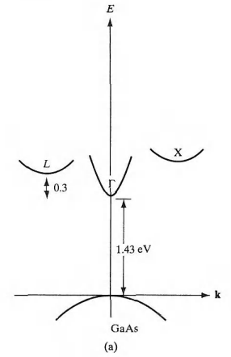
Effective Mass
The electron effective mass in GaAs is much smaller in the direct Γ conduction band (strong curvature) than in the L or X minima (weaker curvature, smaller value in the denominator of the m* expression).

Slide 11

Effective Mass
Note That:
the cur­vature of d²E/dk² is positive at the conduction band minima, but is negative at the valence band maxima.
Thus, the electrons near the top of the valence band have negative effective mass,
Valence band elec­trons with negative charge and negative mass move in an electric field in the same direction as holes with positive charge and positive mass.
we can fully account for charge transport in the valence band by considering hole motion.
For a band centered at k = 0 (such as the Γ band in GaAs), the (E, k) relationship near the minimum is usually parabolic.

Slide 12
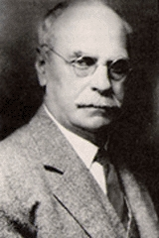
Hall Effect
In 1879, while working on his doctoral thesis, Hall was pursuing the question first posed by Maxwell as to whether the resistance of a coil excited by a current was affected by the presence of a magnet.
Does the force act on the conductor or the current?
Hall argued that if the current was affected by the magnetic field then there should be "a state of stress... the electricity passing toward one side of the wire."
Edwin H. Hall
1855 - 1938
If a current carrying conductor is placed in a transverse magnetic field, potential is developed in the conductor in the direction perpendicular to both the current and magnetic field. This phenomenon is known as Hall Effect. It was discovered by Hall in 1879.

Slide 13
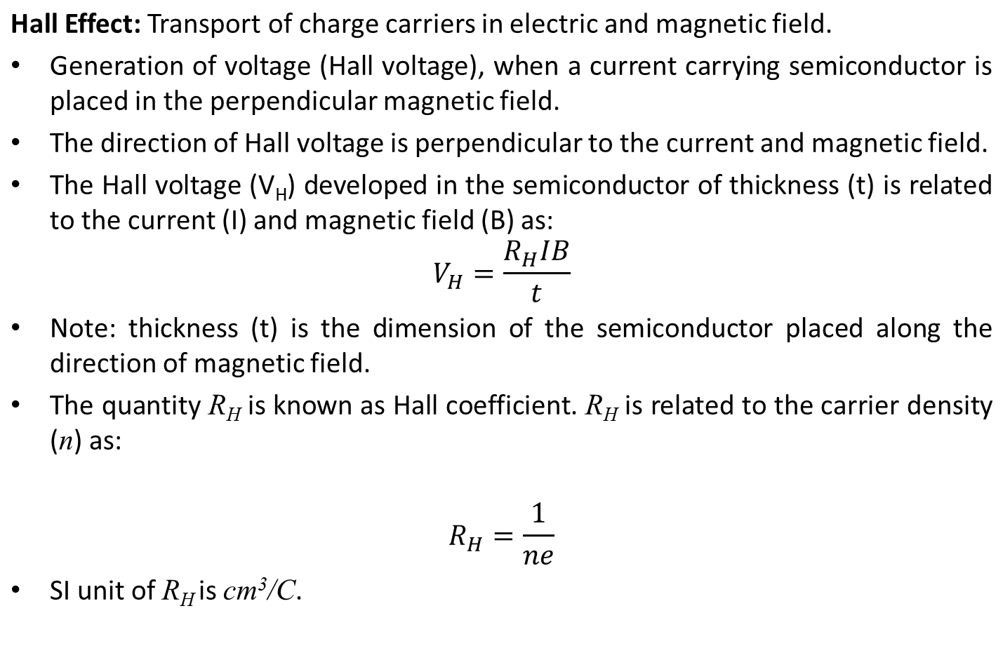
Hall Effect
PHY109 (ENGINEERING PHYSICS)

Slide 14
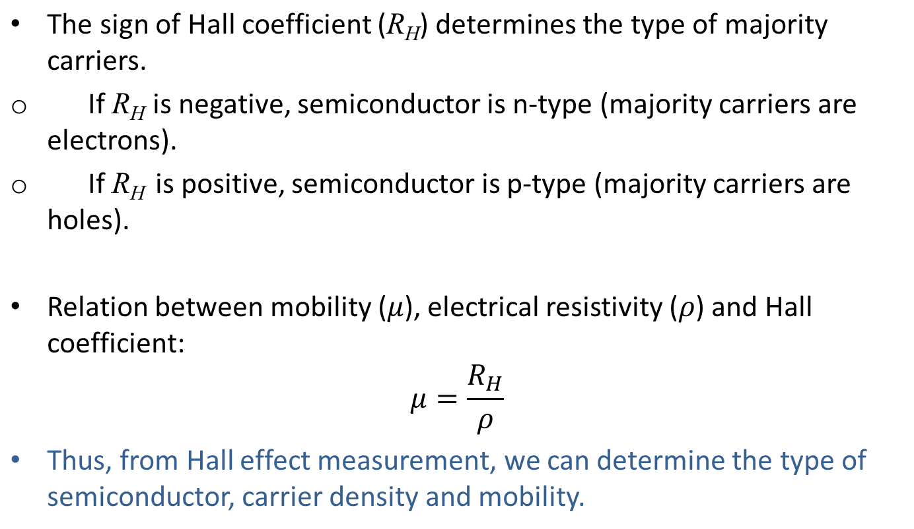
Hall Effect
PHY109 (ENGINEERING PHYSICS)

Slide 15
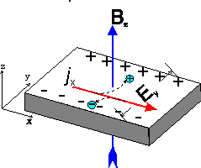
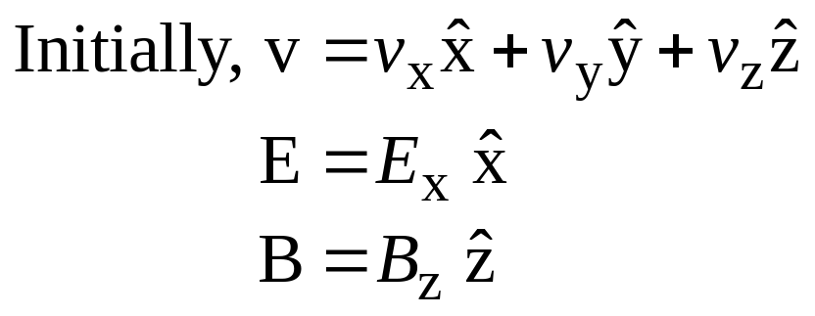
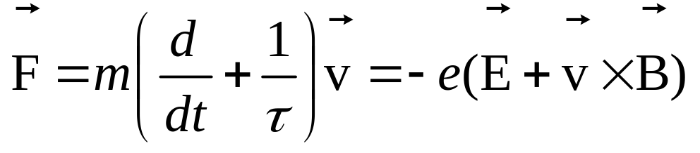
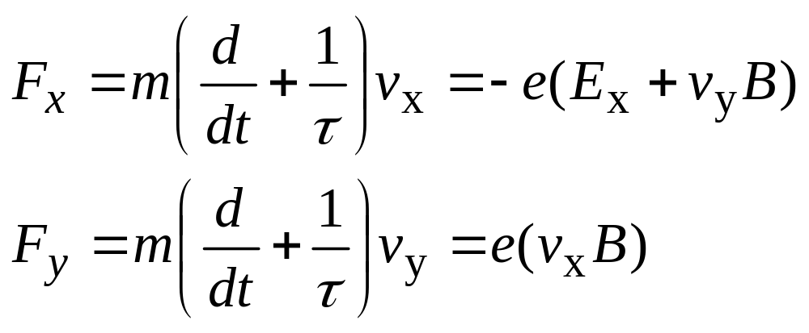
Hall Effect
net force in
−x direction
net force in
−y direction

Slide 16
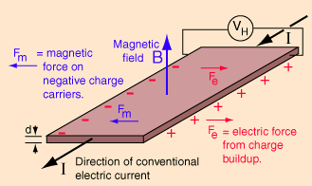
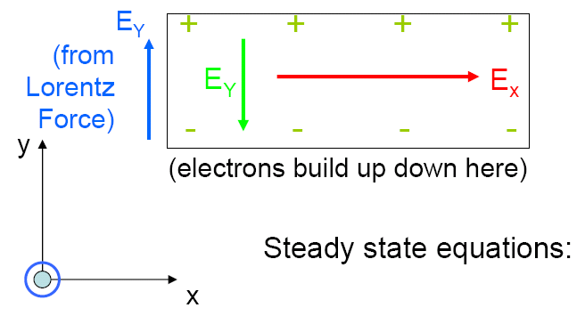
Hall Effect
As a result, electrons move in the −y direction and an electric field component appears in the y direction, E_{y}. This will continue until the Lorentz force is equal and opposite to the electric force due to the buildup of electrons – that is, a steady condition arises.
B
Notes:
The Hall Effect occurs when we apply an electric field in the x-direction and a magnetic field in the z-direction (which generates an electric field in the y-direction).

Slide 17
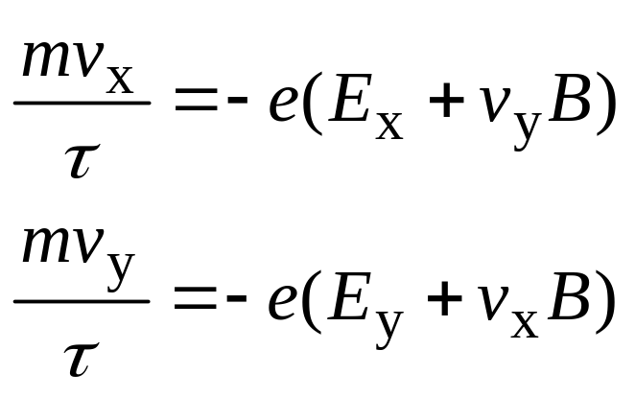
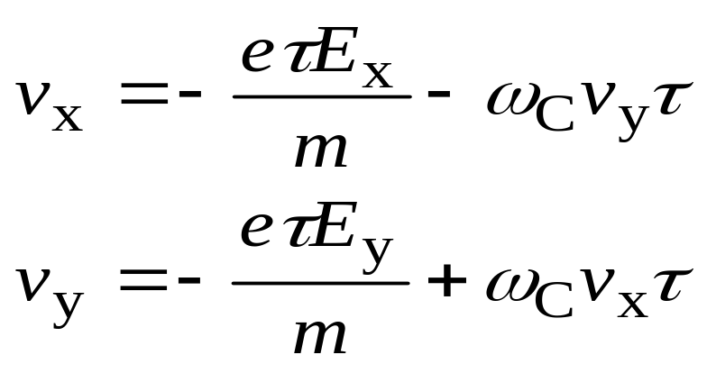
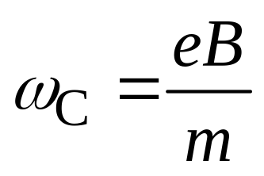

Hall Effect
Steady State
Conditon
Let
Notes:
For electrons moving in the z-direction, we have: v_{z}= 0 (they don’t feel the magnetic field), unless there is an electric field and then we have: v_{z}= -(eτ/m)E_{z}.
Cyclotron Frequency
If the current can’t flow out of the metal in the y-direction, then in the steady state, the velocity of the electrons in the y-direction must be zero (v_{y}= 0).

Slide 18
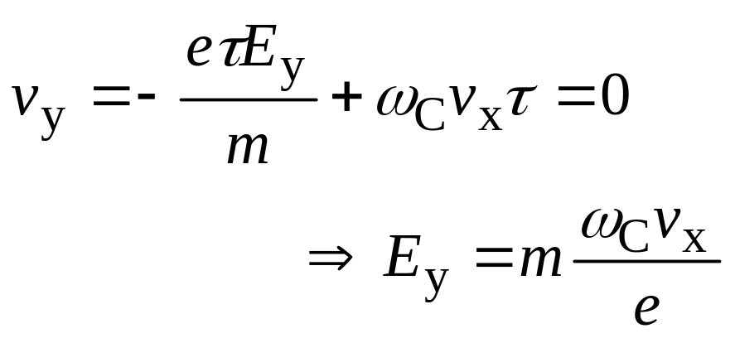
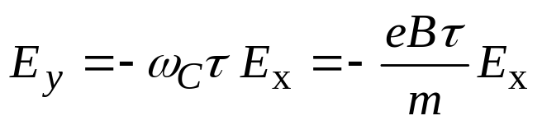
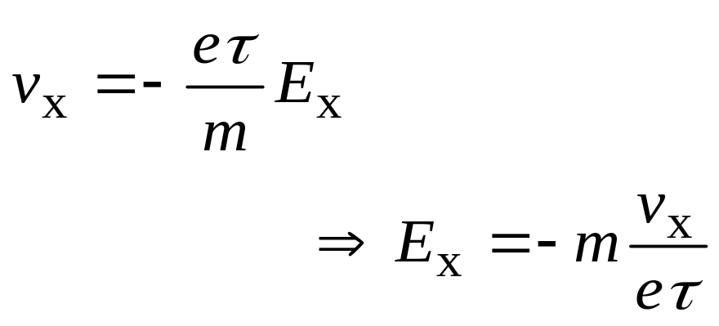
Hall Effect
Notes:
So, what happens is that we get a net flow of electrons in the x-direction, but we also get an electric field set up in the y-direction.
Hall Effect measurements compare the ratio of the field created in the y-direction, to the current in the x-direction, and the magnetic field in the z-direction.

Slide 19
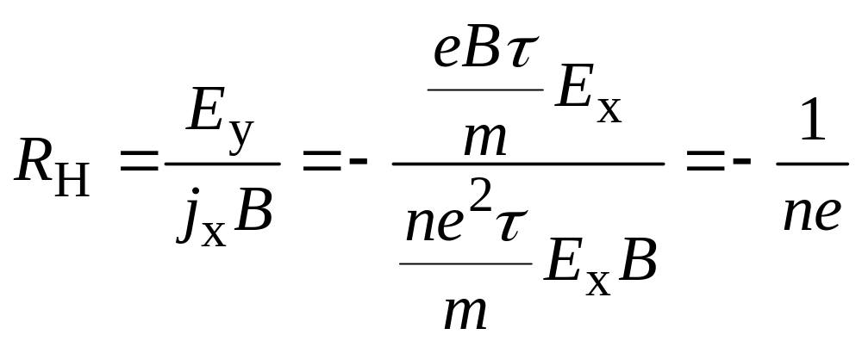
Hall Effect
The Hall coefficient is defined as:
Conduction
Electron
Density
For copper:
n = 8.47 × 10²⁸ electrons/m³.

Slide 20
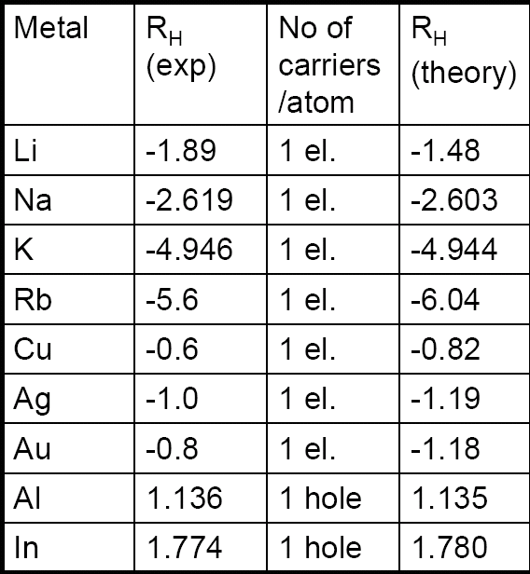
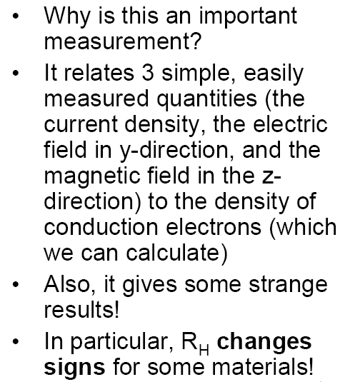
Hall Effect

Slide 21
Hall Effect: Electrons & Holes
The Hall Effect experiment suggests that a carrier can have a positive charge.
These carriers are “holes” in the electron sea - the absence of an electron acts as a net positive charge. These were first explained by Heisenberg.
We can’t explain why this would happen with our free electron theory.
Note: the conditions we derived for the steady state can be invalid for several conditions (for example, when there is a distribution of collision times). But in general, it is a very powerful tool for looking at properties of materials.

Slide 22
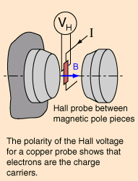
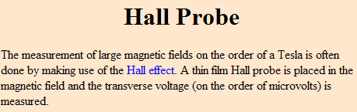
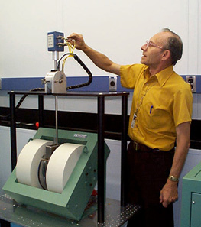
Hall Effect: Applications
For a 100-μm thick Cu film, in a 1.0 T magnetic field and through which I = 0.5 A is passing, the Hall voltage is 0.737 μV.
Notes:
For many years the Hall effect was not used in practical applications because the generated voltage in the gold film was extremely low. However, in the second half of the 20th century the mass production of semiconductor chips started. Chips based on the Hall effect became inexpensive and widely available.

Slide 23
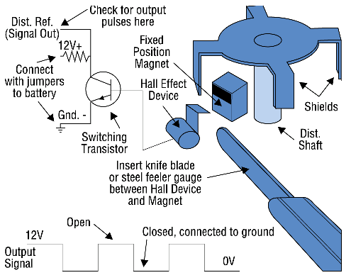
Hall Effect: Applications
Hall-Effect Position Sensors
Hall-Effect position sensors have replaced ignition points in many distributors and are used to directly detect crank and/or cam position on distributorless ignition systems (DIS), telling the computer when to fire the coils. Hall-Effect sensors produce a voltage proportional to the strength of a magnetic field passing through them, which can come from a permanent magnet or an electric current. Since magnetic field strength is proportional to an electric current, Hall-Effect sensors can measure current. They convert the magnetic field into millivolts that can be read by a DMM.
Notes:
But they are also used in many distributorless ignition systems (DIS) to determine the position of the crankshaft and camshaft. This is because the engine computer needs to know where the number one cylinder is as soon as the engine is cranked. As soon as the all-important “sync-pulse” is detected, the ignition module can start firing the plugs in the correct sequence. This also allows injector timing to be matched to the firing order in engines with sequential fuel injection.
Hall Effect Sensors are sometimes referred to as “switches” rather than sensors because of the on-off “digital” voltage signal they produce. Unlike magnetic sensors that produce an alternating current (AC) signal which varies in voltage with speed, Hall Effect Sensors produce a constant voltage signal that can change abruptly from maximum voltage to nearly zero and back again regardless of engine speed.
This produces a square wave output signal that can be easily used by the onboard computer for timing purposes.

